Slide 1

Data Salon
A Robust and Sparse Process Fault
Detection Method Based on RSPCA
Peng Peng
2019. 11.26

Slide 2

Outline
In this lecture, we will introduce some ideas about how to start your research.
The key ideas of the paper
Rethinking of the paper
How to avoid writing the garbage

Slide 3
Motivation
离线阶段
离线阶段
？
正常数据
监测模型
正常+异常数据
监测模型
离线阶段
离线阶段
×
×
剔除异常数据/降低异常数据的影响
正常+异常数据
鲁棒监测模型

Slide 4
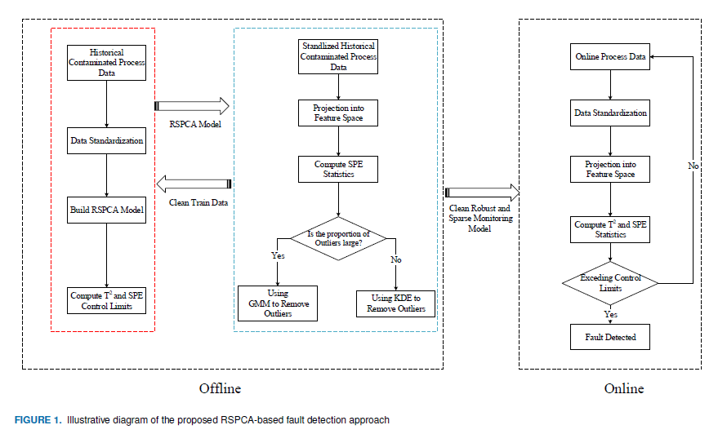
Key ideas
How to build the RSPCA model? (Modelling and Solution?)
The outliers removing strategy(Why GMM and KDE) ?
The integration of GA

Slide 5


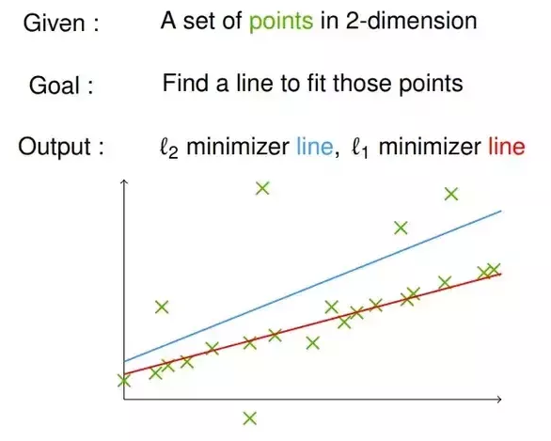
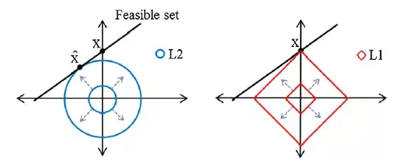
L1 Norm
Question? We know L1 norm can help us get a sparse or robust solution. So under what situation can we get a sparse solution? Under what situation can we get a robust solution?
Answer! L1 regularization , L1 loss function
https://www.quora.com/Why-is-L1-regularization-better-than-L2-regularization-provided-that-all-Norms-are-equivalent

Slide 6
L1 Norm for sparse
Question? (Why not L0 norm?)
L0 norm is non-convex. The L0-optimization problem is known to be NP-hard.
Convex relaxation!
L1-solutions as a good approximation to L0.
Tibshirani R, Wasserman L. A Closer Look at Sparse Regression[J]. 2016.

Slide 7




Robust PCA
Modeling: Similar to L2-PCA
L2-PCA
L1-PCA
Solution: You can find the detailed solution in the reference below.
Kwak N. Principal component analysis based on L1-norm maximization[J]. IEEE transactions on pattern analysis and machine intelligence, 2008, 30(9): 1672-1680.

Slide 8
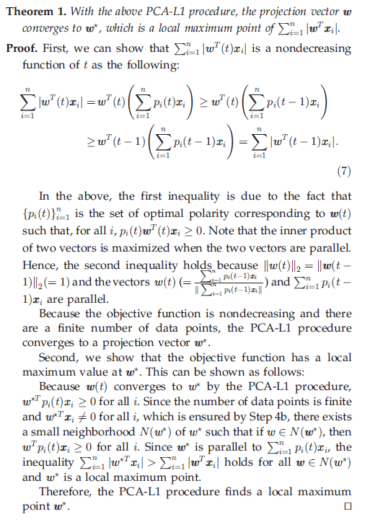
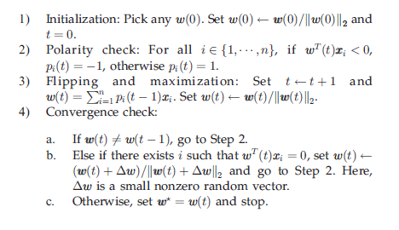
Robust PCA
Kwak N. Principal component analysis based on L1-norm maximization[J]. IEEE transactions on pattern analysis and machine intelligence, 2008, 30(9): 1672-1680.

Slide 9
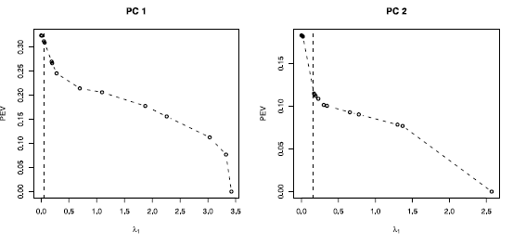

Sparse PCA
Modeling: Guess it!
Notes: How to choose
Each sparse approximation explained almost the same amount of variance as the ordinary PC did
Zou H, Hastie T, Tibshirani R. Sparse principal component analysis[J]. Journal of computational and graphical statistics, 2006, 15(2): 265-286.

Slide 10
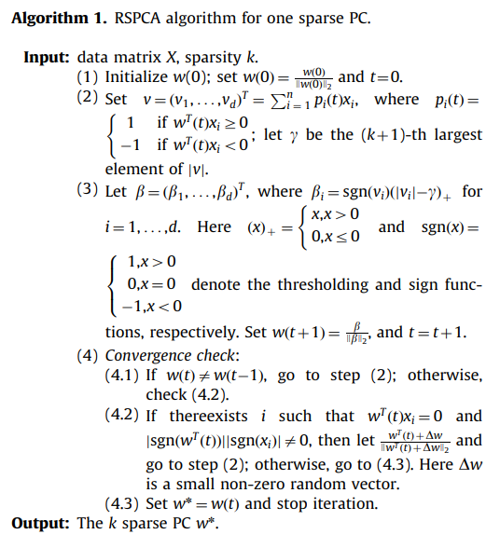

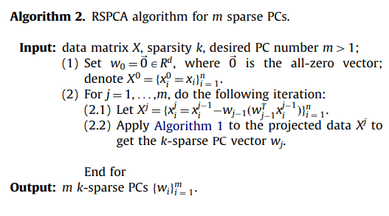
Robust sparse PCA
Robust sparse PCA
Solution
Meng D, Zhao Q, Xu Z. Improve robustness of sparse PCA by L1-norm maximization[J]. Pattern Recognition, 2012, 45(1): 487-497.

Slide 11
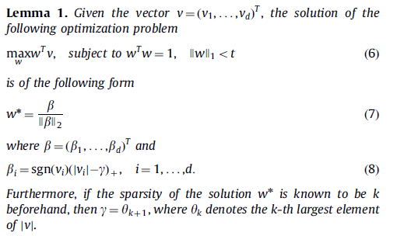
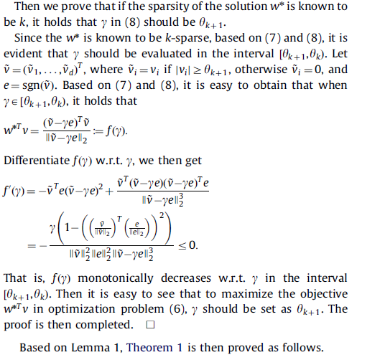

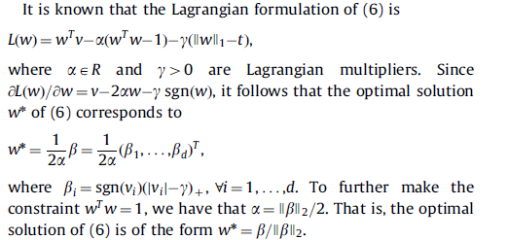
Robust sparse PCA
Meng D, Zhao Q, Xu Z. Improve robustness of sparse PCA by L1-norm maximization[J]. Pattern Recognition, 2012, 45(1): 487-497.

Slide 12
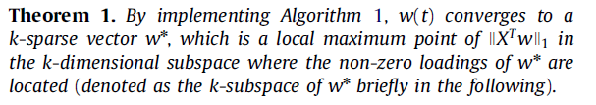
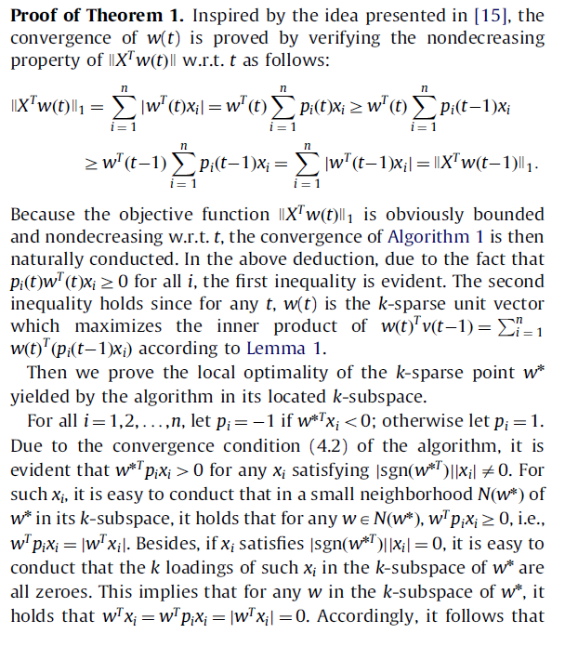
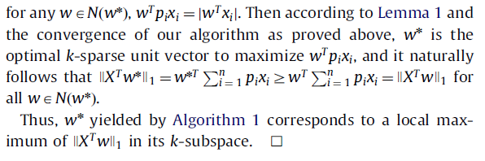
Robust sparse PCA
Meng D, Zhao Q, Xu Z. Improve robustness of sparse PCA by L1-norm maximization[J]. Pattern Recognition, 2012, 45(1): 487-497.

Slide 13
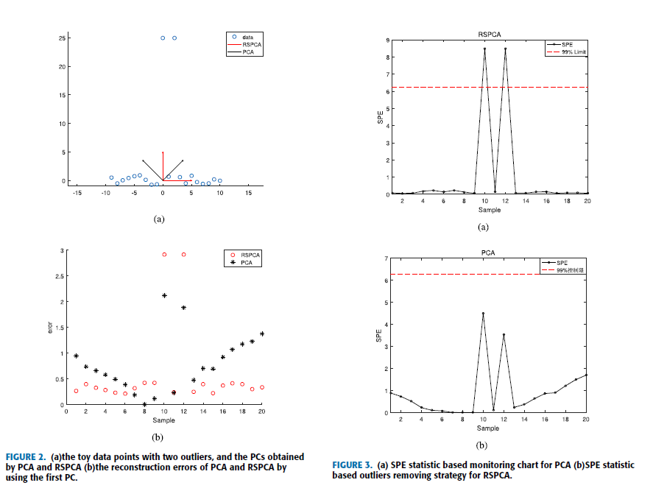
Case
We first demonstrate the robustness of the proposed RSPCA process monitoring model and the outliers removing strategy based on SPE
statistic in a 2D toy data set. The first dimension of the data is
generated by picking xi from the interval [-9,10] with a same step size
1. The second dimension of the data are generated by sampling yi
from the uniform distribution [-1, 1], except at xi = 0 and xi =1, and the value of yis is set around 25.
Peng P, Zhang Y, Liu F, et al. A Robust and Sparse Process Fault Detection Method Based on RSPCA[J]. IEEE Access, 2019, 7: 133799-133811.

Slide 14
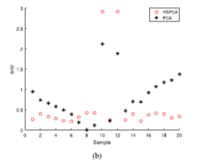
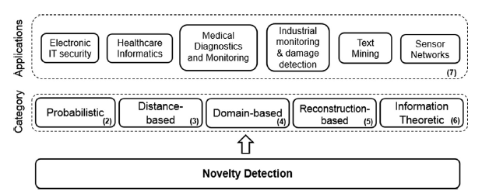
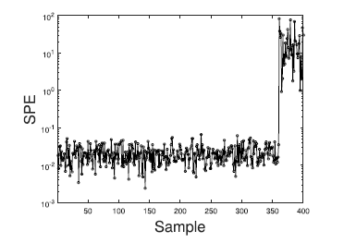
Outliers Removing
GMM?KDE?
Do the Distance-based methods work?
Pimentel M A F, Clifton D A, Clifton L, et al. A review of novelty detection[J]. Signal Processing, 2014, 99: 215-249.
Peng P, Zhang Y, Liu F, et al. A Robust and Sparse Process Fault Detection Method Based on RSPCA[J]. IEEE Access, 2019, 7: 133799-133811.

Slide 15
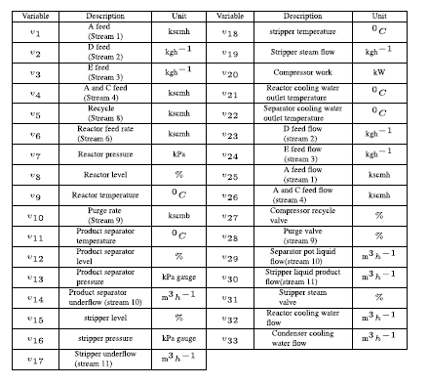

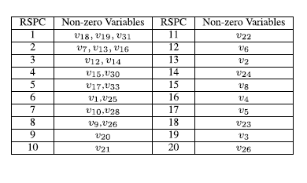
GA
Sparsity k for each sparse PC
Combinational optimization problem
Peng P, Zhang Y, Liu F, et al. A Robust and Sparse Process Fault Detection Method Based on RSPCA[J]. IEEE Access, 2019, 7: 133799-133811.

Slide 16
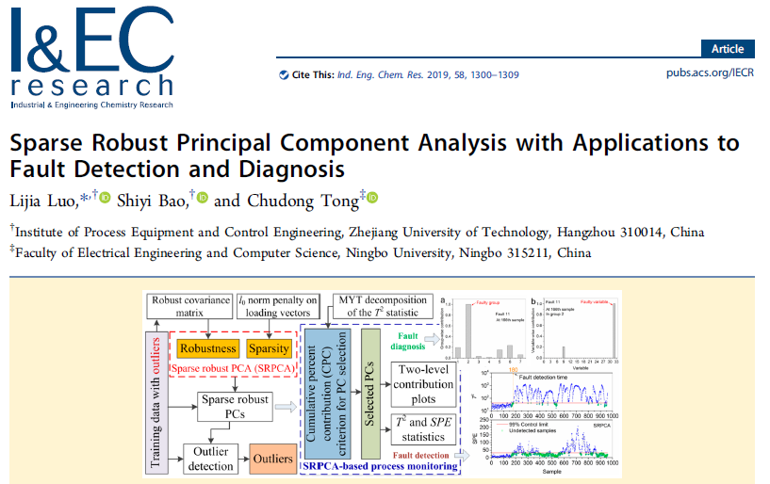



Pros and cons
Luo L, Bao S, Tong C. Sparse robust principal component analysis with applications to fault detection and diagnosis[J]. Industrial & Engineering Chemistry Research, 2019, 58(3): 1300-1309.

Slide 17
Pros and cons
Pros: A point worth studying
Cons
Outdated
Article about engineering actually, a combination of some techniques
Suggestion
Do some theoretical problems

Slide 18
Data Salon
THANK YOU!

